Slide 1
Object/Image Recognition
Exploring
Convolutional Neural Network(s) (CNN)
Results and Conclusion

Slide 2
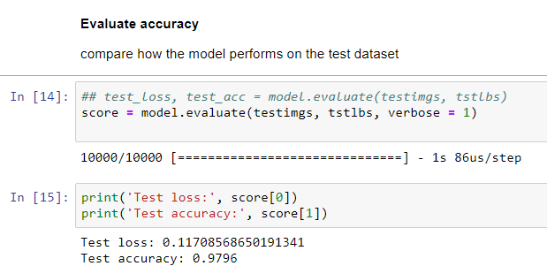
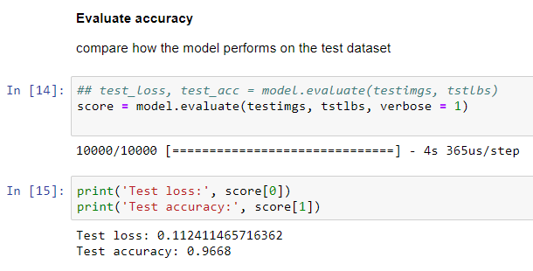
Results and Conclusion
Comparing NN to CNN Image Recognition Accuracy
Accuracy: 98% - This is the Benchmark
This is considered acceptable, most Accuracy checks that are greater than 95% is considered good.
CNN Accuracy: 97%
This is considered acceptable, most Accuracy checks that are greater than 95% is considered good.

Slide 3
Results and Conclusion
Comparing NN to CNN Image Recognition Accuracy
Comparing the Accuracy of each Model:
Ref
1) https://keras.io/models/sequential/
It is intentional in keeping most of the pipeline steps identical (i.e. see the compile and training steps). The NN Model and CNN Model are distinctly different for performance comparisons shown below
Both models are built from TensorFlow/Keras using the Keras Sequential API described at ref(1).
The Simple Neural Network (without convolution) is Keras Sequential model. This is what is being compared to the Keras Sequential CNN (with convolution).
Summary:
Each Model was designed in a relatively simple form to keep pipeline processing similar for comparison purposes. The results are
NN Accuracy: 98%
CNN Accuracy: 97%
The results show that there is no significant difference in Accuracy between the NN and CNN for this experiment by changing only the models.
Improvements can be made in both Models and Training. One example of improvement can be done by increasing the number of epochs (this could not be done on my laptop because the run times turns in days vs. hours).

